Slide 1

Next-Gen EMS: Smart Energy Management System (EMS) with Real-Time Monitoring
Team Name: Flux
VidyutAI Hackathon 2025
October 04th-05th 2025

Slide 2
Introduction of team
Parth Thorat
Himani Prajapati
Aditi Jadav

Slide 3
The Challenge: Modern Energy Management Problems
Volatile Generation: Solar/Wind fluctuations cause voltage & frequency issues
EV Load Stress: Unpredictable charging peaks strain local grids
Diagnostic Complexity: Hard to identify faults in inverters, motors
Reactive Approach: Lack of visibility forces emergency fixes instead of preventive management

Slide 4
Why It's Worthy of Solving
Critical for mass adoption of renewables and EVs.
Prevents costly grid failures and blackouts.
Reduces operational costs and carbon footprint for microgrids.
Moves the energy sector from reactive firefighting to intelligent, predictive control.

Slide 5
Our Solution: VidyutAI Smart EMS
Real-Time Monitoring - Live dashboards for all subsystems
Smart Diagnostics - Health indices & plain-English fault predictions
Proactive Alerts - Actionable recommendations, not just warnings
AI-Driven Optimization - RL-powered scheduling for cost & emission savings

Slide 6
Dataset
Dataset 1: Solar Power Generation Data
Source: Kaggle | Anikannal Solar Power
Content: Historical solar generation data from multiple plants
Dataset 2: Comprehensive Energy Management Data
Source: Mendeley | Smart energy systems dataset
Content: Multi-parameter data (load, generation, storage, weather)

Slide 7
Technical Aspects & Feasibility of Solution
Backend Architecture:
API Layer/Fast API
Database(Influx DB)
Real-time Processing
Data Pipeline(Docker)
Frontend Dashboard:
Framework(React JS)
Visualization(Linechart)
UI Library(Bootstrap)

Slide 8
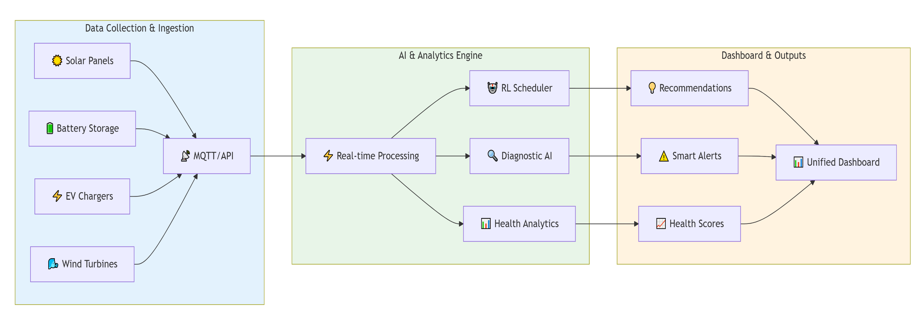
Fig 1: Real-Time Data Pipeline

Slide 9
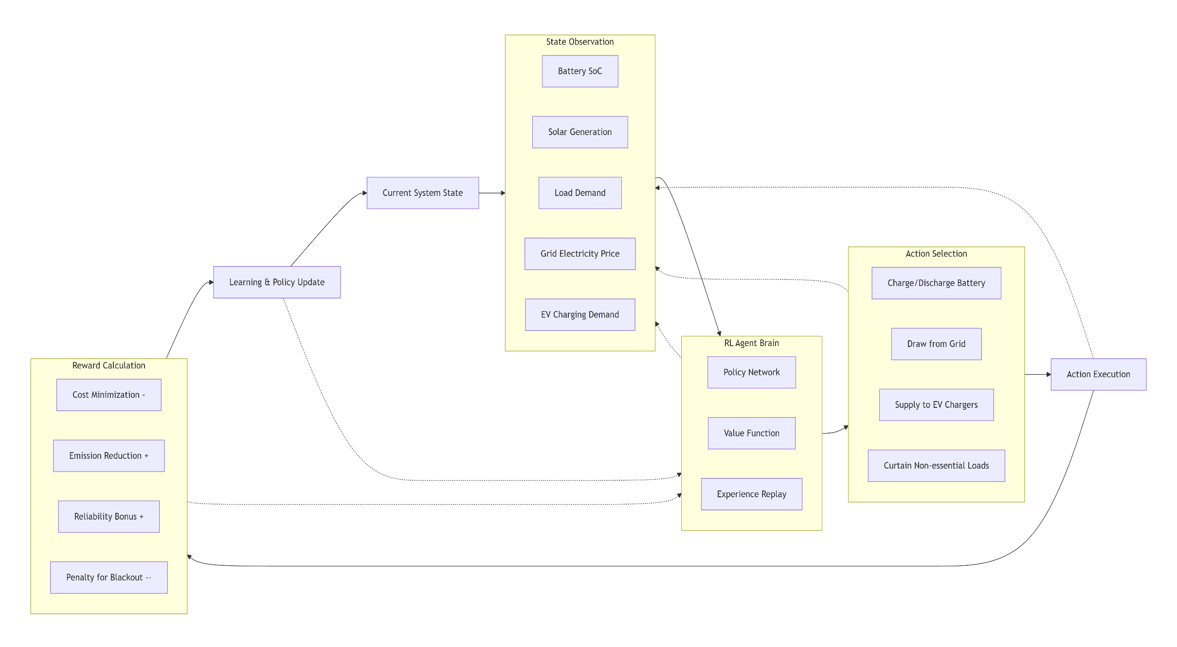
Fig 2: RL Scheduler Decision Flow

Slide 10
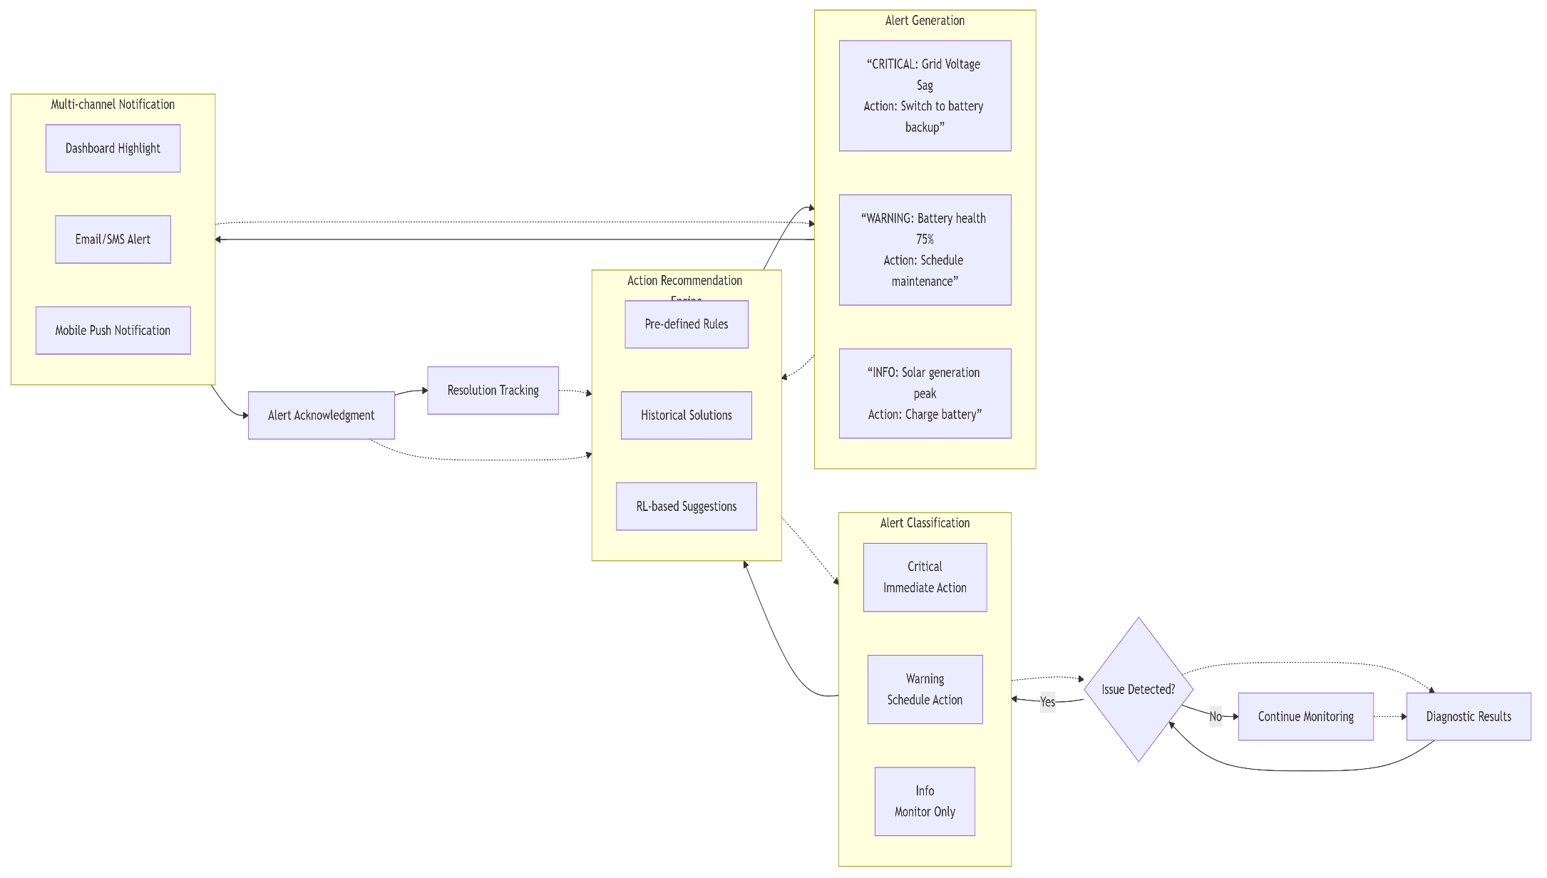
Fig 3: Alert & Advisory System Flow

Slide 11
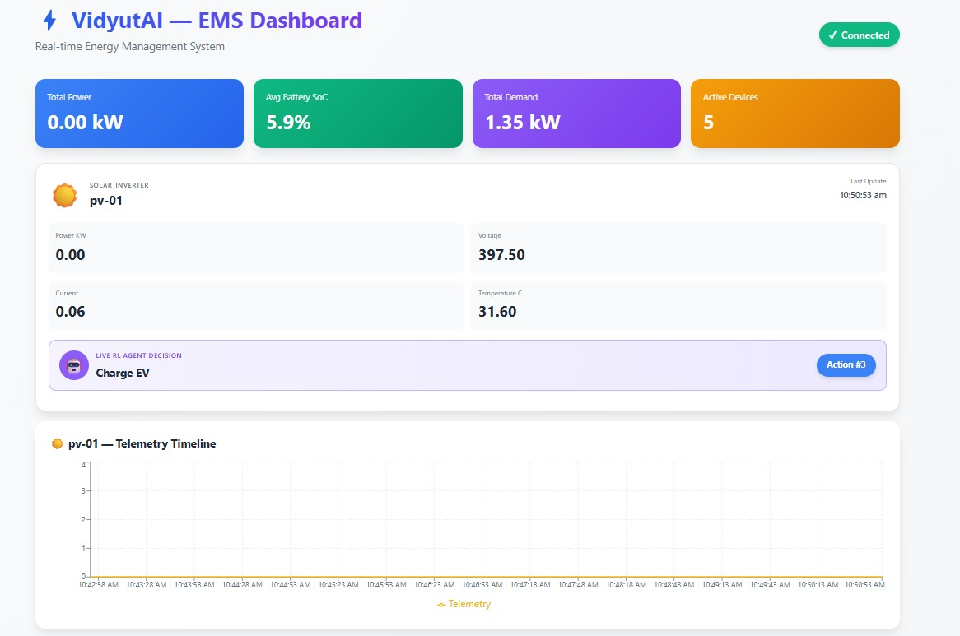
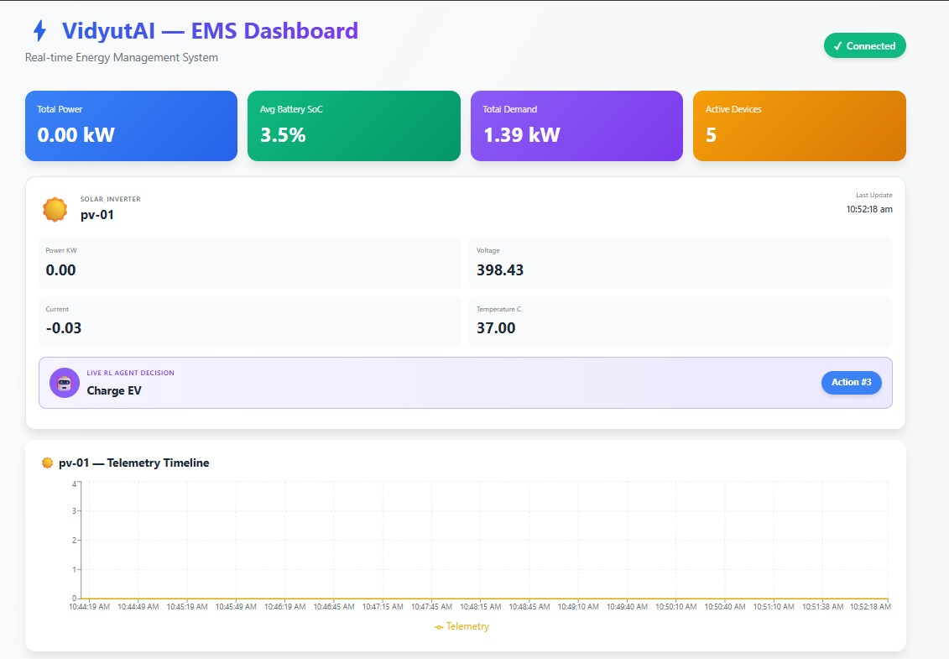
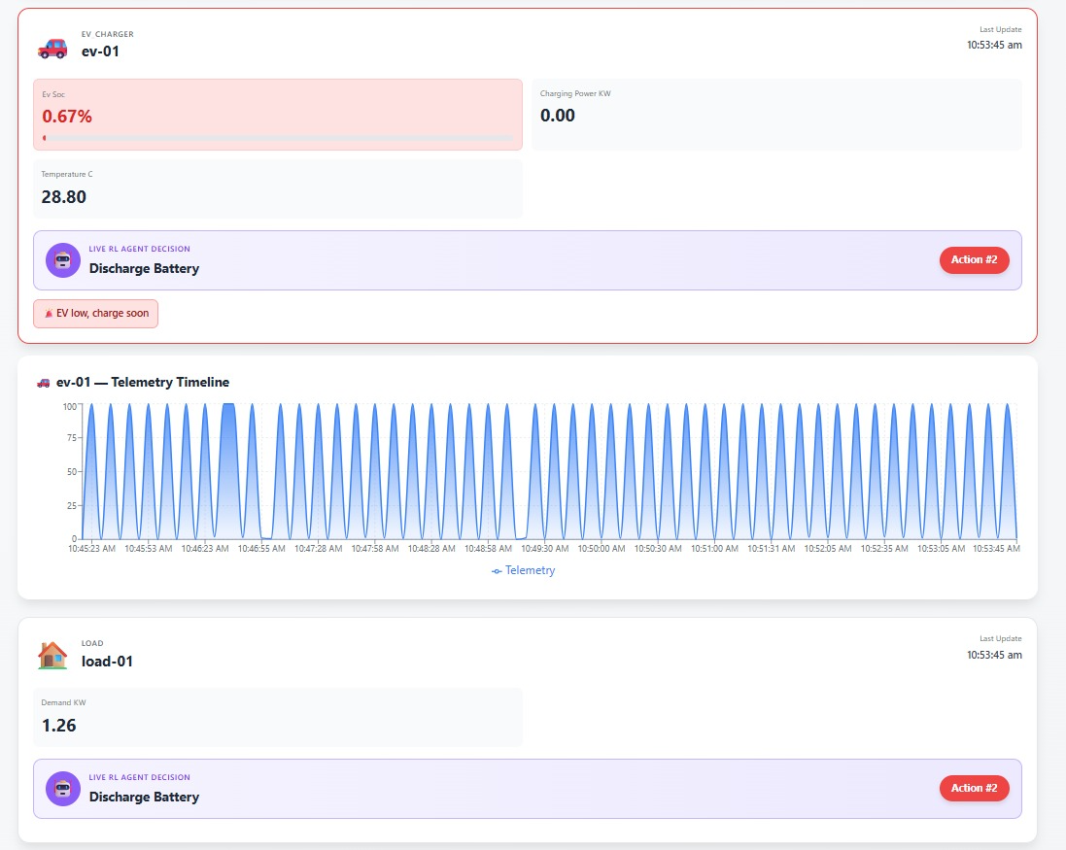
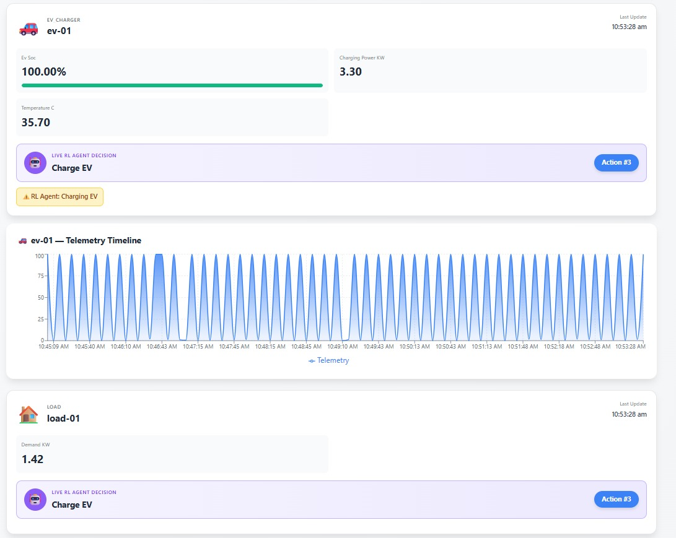
Live Demo - Unified Dashboard
(A)
(B)
Solar :
(A)
(B)
EV:

Slide 12
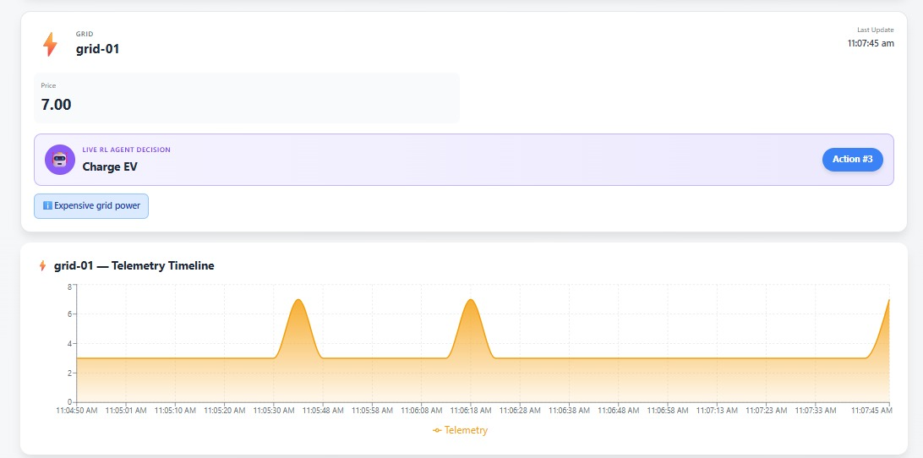
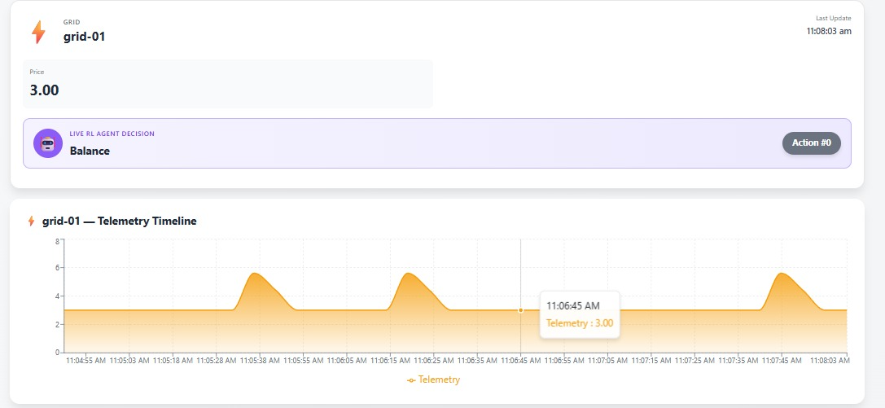
(A)
Grid:
(B)

Slide 13
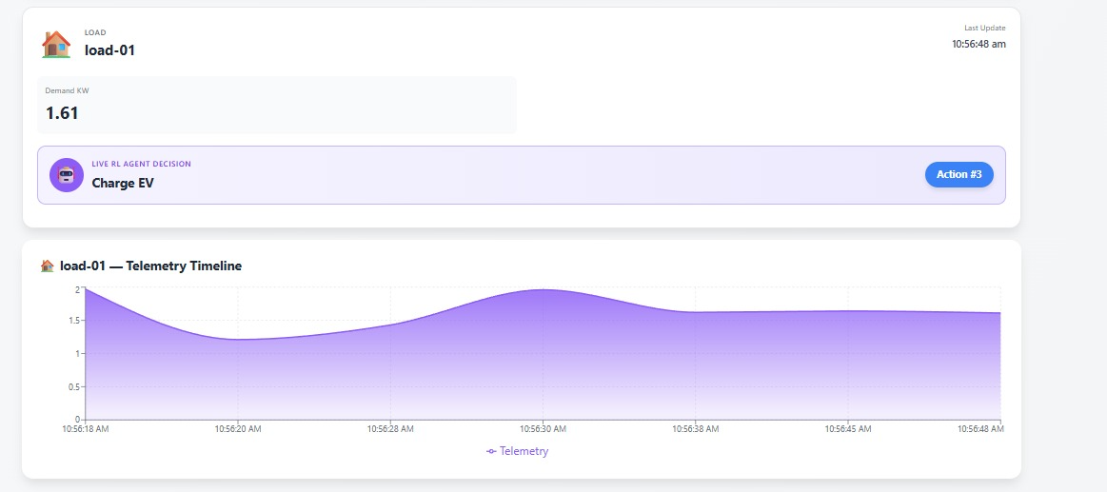
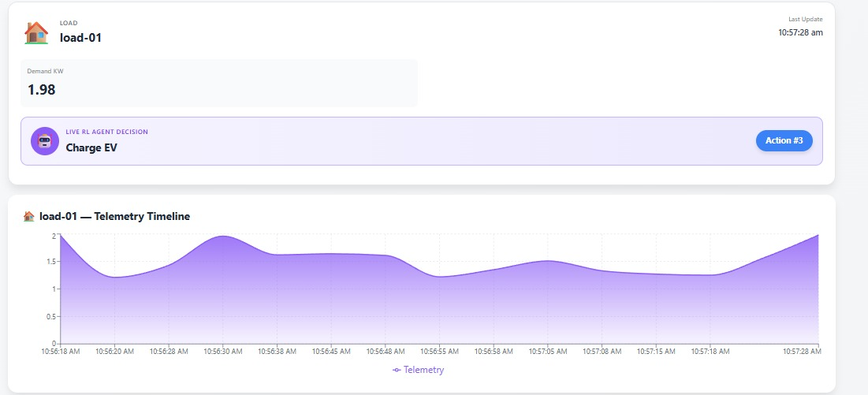
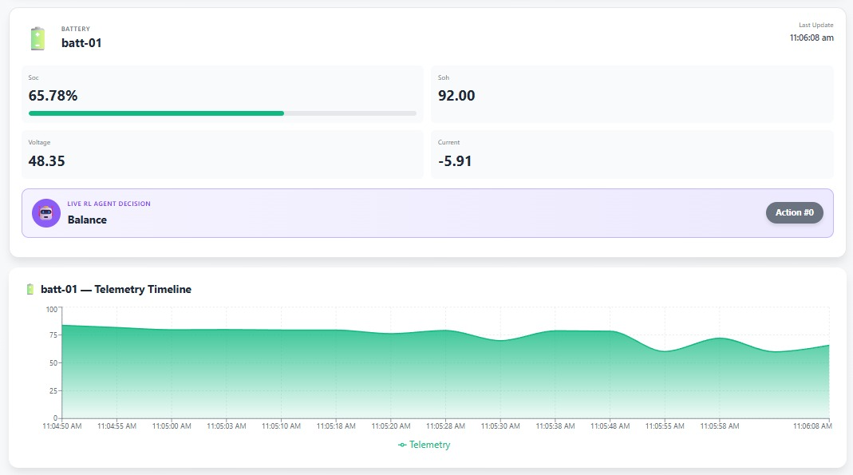
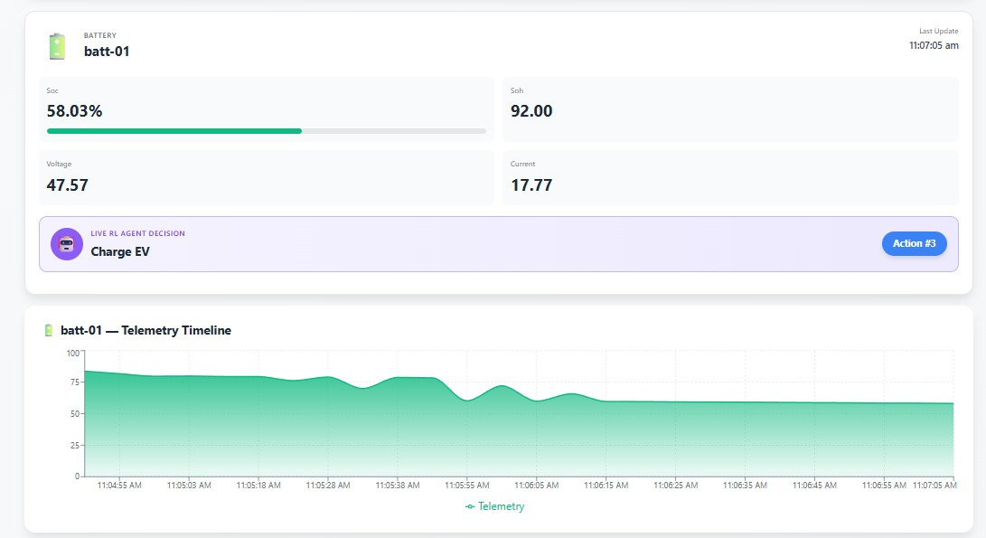
(A)
(B)
Load:
(A)
(B)
Battery:

Slide 14
Benefits to Users
Prevent Downtime: Catch issues before they cause failures.
Reduce Costs: Optimize energy use and reduce peak demand charges.
Simplify Operations: Plain-English diagnostics reduce troubleshooting time.
Improve Sustainability: Lower emissions through intelligent scheduling.

Slide 15
Scalability of Solution
Cloud-Native Architecture: Can handle data from a single building to a city-wide grid.
Modular Design: Easy to add new asset types (e.g., new inverter models, EV chargers).
Cost-Effective: Backend costs scale linearly with usage.

Slide 16
Key Achievements & Deliverables
Diagnostics Module - Clear health indices & plain-English insights
Alerts & Advisory System - Actionable recommendations with priorities
Unified Dashboard - Live monitoring, alerts, and energy flows

Slide 17
Future Plan
Predictive Maintenance 2.0: Enhanced AI with Ensemble Methods for superior accuracy and longer asset life.
Grid Resilience 2.0: VOTI Technology for advanced Voltage, Oscillation, and Transient Instability analysis.
Weather Integration: Forecast-driven energy optimization.
Mobile Technician App: Real-time alerts and diagnostics on-the-go.
Blockchain Integration: Peer-to-peer energy trading capabilities.

Slide 18
Conclusion
VidyutAI EMS transforms energy management from reactive to predictive.
We deliver intelligent microgrid control through real-time IoT analytics and AI-powered optimization.
We are ready to build the future of energy.

Slide 19
Thank You!

